Slide 1

DESIGN AND PERFORMANCE ANALYSIS OF MTCMOS-BASED RCA AND VARIABLE BLOCK CSLA ARCHITECTURES IN 90 NM CMOS
Presented By:
RAVI RAJ
24171110006
Supervised By:
Dr. Mrinal Ranjan
Assistant Professor
Electrical and Electronics Engineering
Co-Supervised By:
Dr. Rajan Sarkar
Associate Professor and Head of Department
Electrical and Electronics Engineering
DEPARTMENT OF ELECTRONICS & COMMUNICATION ENGINEERING GAYA COLLEGE OF ENGINEERING, GAYA - 823003, BIHAR

Slide 2
Presentation Outline
Introduction & motivation
Problem Statement
Literature review
Objectives
Theoretical Background
Methodology
Circuit Implementation
Simulation Results
Future Works
Conclusion

Slide 3
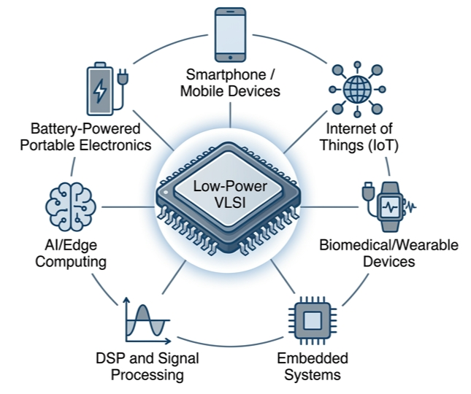
introduction
In the deep submicron regime, leakage power has surpassed dynamic power as the primary design challenge.
Arithmetic units (ALUs) are the backbone of DSPs and microprocessors.
Adders are core components in every computational block.
Scaling of threshold voltage (V_{th}) leads to exponential increase in leakage.
Leakage-aware arithmetic circuit design is essential for modern energy-efficient systems.
Therefore, low-power arithmetic circuit design has become an important research area in modern VLSI systems.
Fig. 1: Low-Power VLSI Applications

Slide 4
Problem Statement
Leakage power increases significantly in deep submicron CMOS technologies.
RCA offers simple architecture but suffers from large carry propagation delay.
CSLA improves speed performance but increases area and power overhead.
Existing low-power adder designs do not provide an optimized balance between leakage, delay, and complexity.
An efficient MTCMOS-based adder architecture is required for low-power VLSI applications.
In nanoscale CMOS technologies, leakage current becomes dominant during standby operation.
Challenge: Reduce leakage power without significant performance degradation.

Slide 5
Literature Review
Several researchers have explored low-power adder architectures and leakage reduction techniques to improve energy efficiency in CMOS systems.
Reference | Year | Contribution | Limitation
[1] P. Balasubramanian et al. | 2018 | Compared CLA and CSLA architectures for speed improvement | Leakage analysis not considered
[2] N. Hanchate and N. Ranganathan | 2014 | Reduced standby leakage using sleep transistors | Area and delay overhead not analyzed
[3] S. Mutoh et al | 2022 | Improved propagation delay using non-uniform grouping | Increased switching activity
[4] B. Ramkumar and H. M. Kittur | 2024 | Discussed leakage-delay trade-off | Limited transistor-level adder analysis
[5] K. Roy et al. | 2025 | Focused on power optimization | Combined RCA-CSLA MTCMOS analysis missing
Research gap: Limited work exists on transistor-level RCA and variable block CSLA architectures integrated with MTCMOS and sleep transistor optimization.

Slide 6



objectives
ARCHITECTURAL DESIGN
Design 4-bit to 32-bit RCA and CSLA using 28T Full Adder cells and 2:1 multiplexer.
POWER GATING
Integrate MTCMOS (Multi-Threshold CMOS) sleep transistors to reduce standby leakage.
OPTIMIZATION
Analyze power, delay, and leakage performance.
Optimize sleep transistor sizing for low-power operation.
To achieve an optimized trade-off between leakage power and propagation delay.

Slide 7
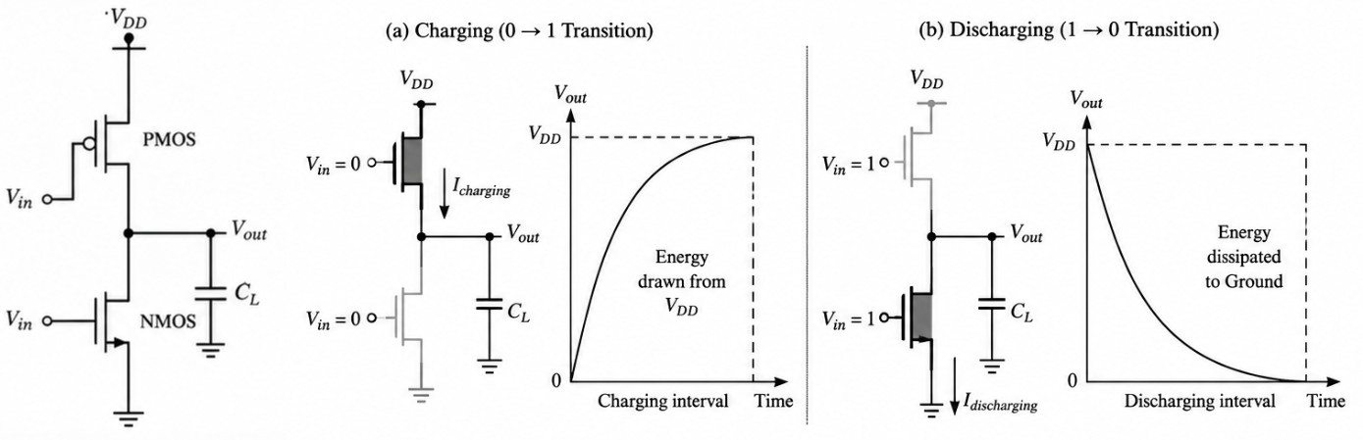
CMOS fundamentals
CMOS uses complementary PMOS and NMOS transistors.
Provides low static power consumption.
High noise immunity and scalability.
Fig. 2: CMOS Inverter Circuit showing charging and discharging

Slide 8
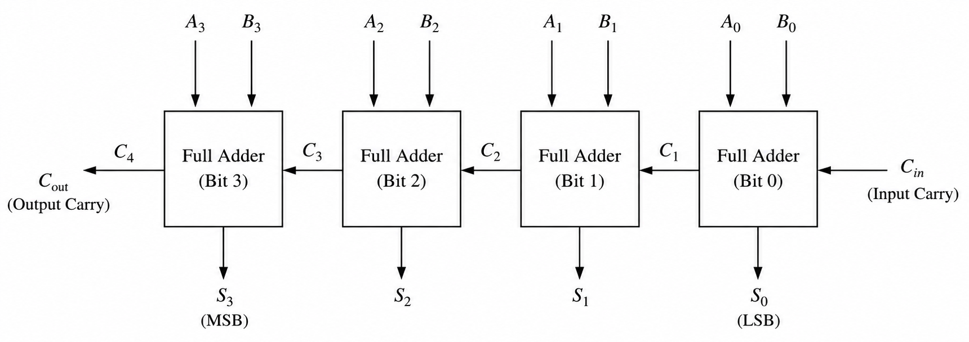

ripple carry adder
Baseline Implementation
The RCA serves as the baseline for performance comparison, representing the simplest yet slowest addition architecture.
Mechanism: Cascaded 1-bit Full Adders where the carry ripples from LSB to MSB.
Pros: Minimal area, simple layout.
Cons: High propagation delay as bit count increases.
$$T_{delay} ≈ N × T_{Carry}$$
Fig. 3: 16-bit Ripple Carry Adder Architecture

Slide 9
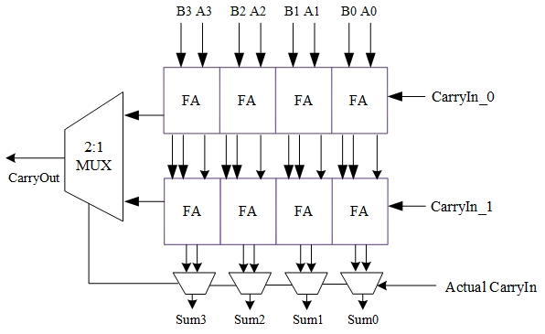
carry select adder
Parallel carry computation
Reduced carry propagation delay
Uses dual RCA and MUX selection
Fig. 4: Basic Carry Select Adder Architecture

Slide 10
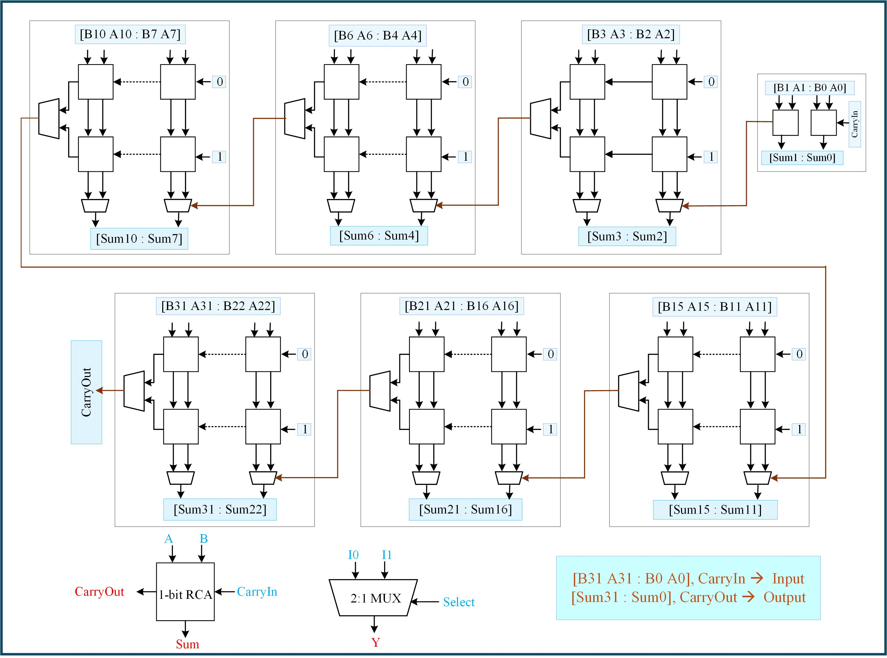
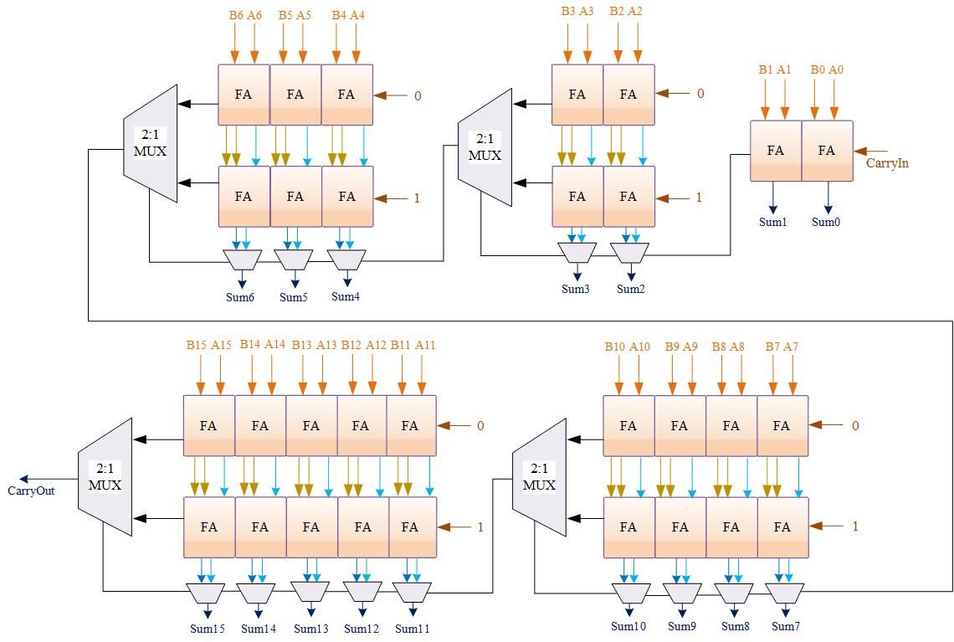
Variable Block carry select adder
Structure: 2-2-3-4-5-bit grouping for 16-bit & 2-2-3-4-5-6-10 bit grouping for 16-bit
Variable blocks balance carry chain and MUX delays.
Parallel carry computation reduces propagation delay.
Multiplexer-based carry selection improves speed performance.
Variable block sizing balances carry propagation
and hardware overhead.
Fig. 5: 16-bit Variable Block CSLA Architecture
Fig. 6: 32-bit Variable Block CSLA Architecture

Slide 11
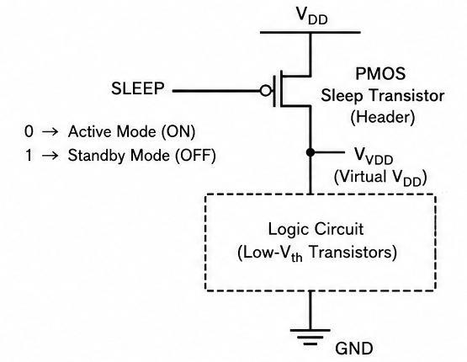
MTCMOS
High V_{t} PMOS header sleep transistor used for power gating.
Virtual VDD disconnects logic block during standby mode.
MTCMOS significantly reduces standby leakage power with moderate delay overhead.
Active Mode: Sleep = 0
Standby Mode: Sleep =1
Fig. 7: MTCMOS Architecture Using PMOS Header Sleep Transistor

Slide 12
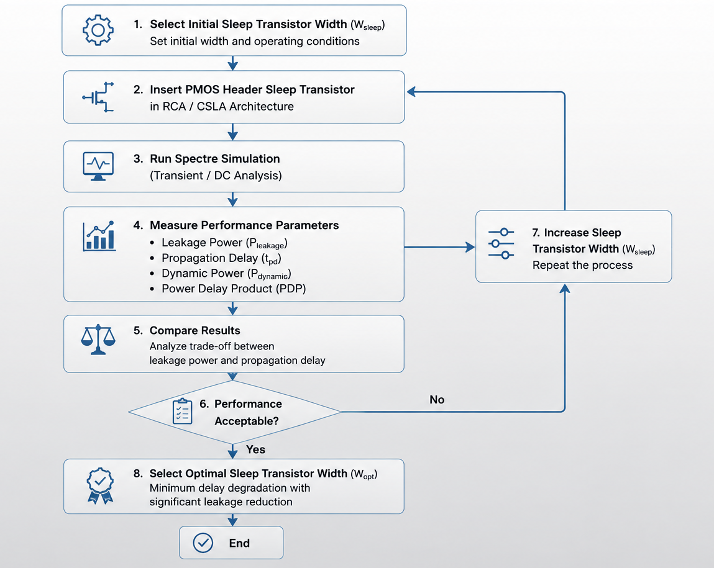
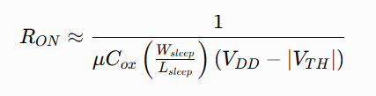

Sleep transistor optimization
Increasing W_{Sleep}​ → reduces RON​ → reduces IR drop → improves delay but increases area and parasitic capacitance.
Fig. 8: Flowchart of Selecting optimal Sleep Transistor Width

Slide 13
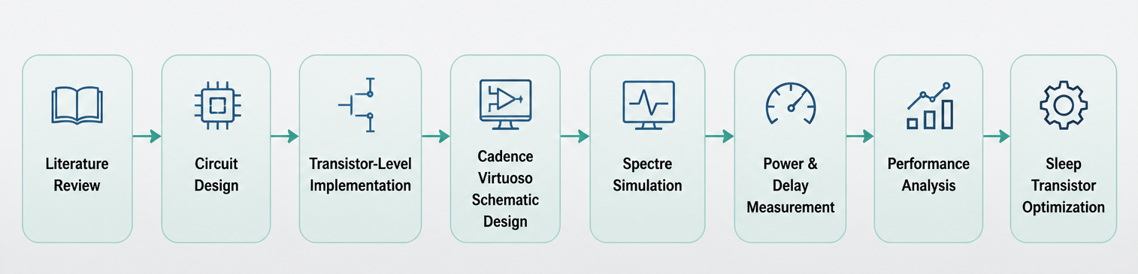
Proposed methodology
Methodology for transistor-level low-power RCA and CSLA design using MTCMOS technique.

Slide 14
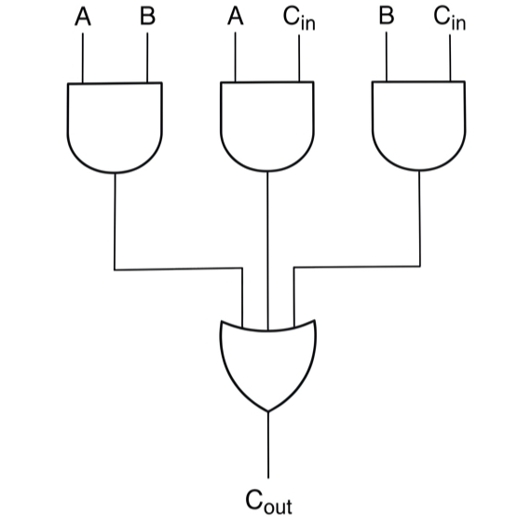
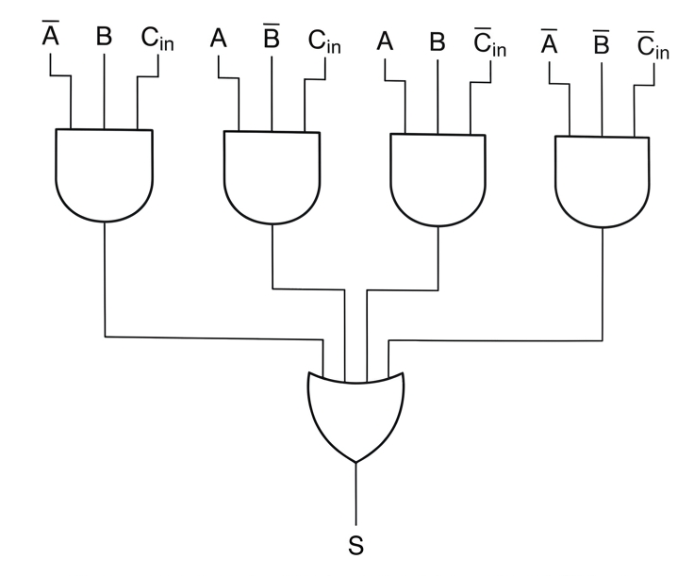
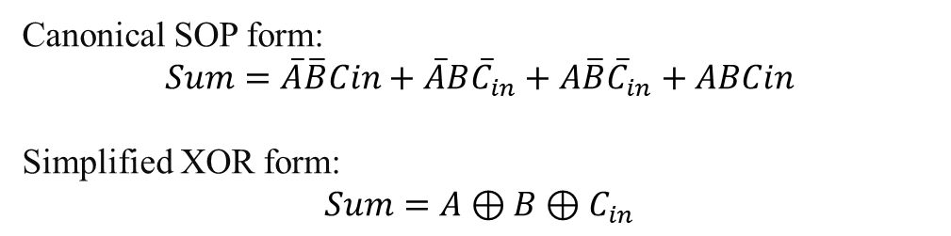
Full adder design
The Full Adder is the primary building block for any N-bit arithmetic circuit.
C_{out} = $A⋅B +B⋅C_{in} +A⋅C_{in}$
Fig. 9.a: AOI logic diagram of Carry-out
Canonical SOP form:
$$Sum=\overline{A}\overline{B}Cin+\overline{A}B{\overline{C}}_{in}+A\overline{B}{\overline{C}}_{in}+ABCin$$
Simplified XOR form:
$$Sum=A⊕B⊕C_{in}$$
Fig. 9.b: AOI logic diagram of Sum

Slide 15
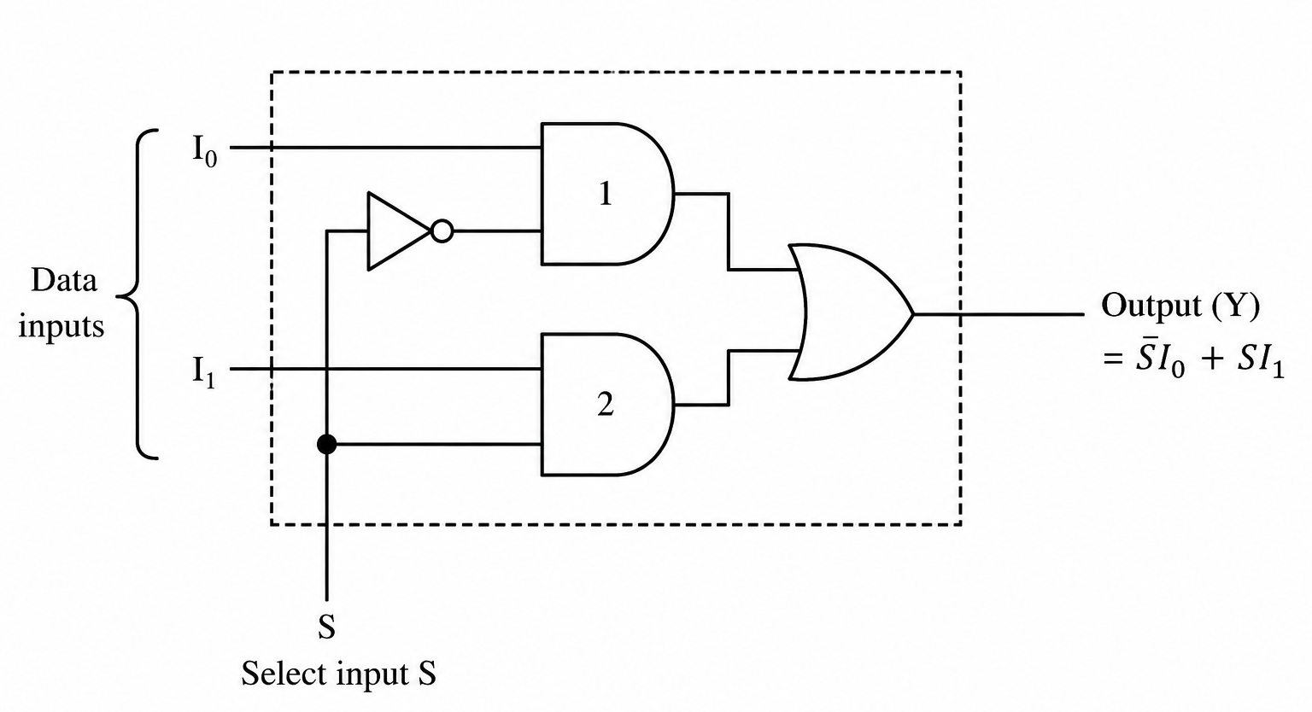

TG MUX Design
$$\begin{matrix} & Y=\overset{‾}{S}I_{0}+SI_{1} & & \end{matrix}$$
Transmission Gate based MUX provides full voltage swing with reduced threshold voltage degradation compared to pass transistor logic.
A critical component for the Carry-Select architecture, implemented using transmission Gate for minimal delay.
TG logic improves signal integrity compared to pass transistor logic.
Fig. 10: AOI logic diagram of 2:1 Multiplexer

Slide 16
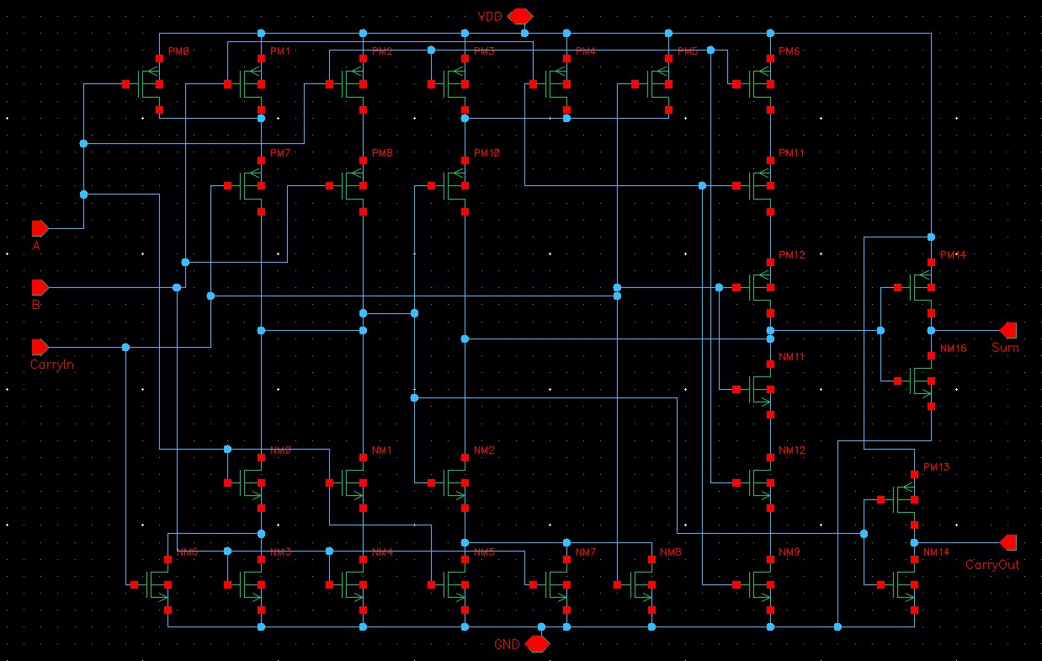
Full adder design
Fig. 11: Cadence Virtuoso Schematic of 1-bit Full Adder

Slide 17
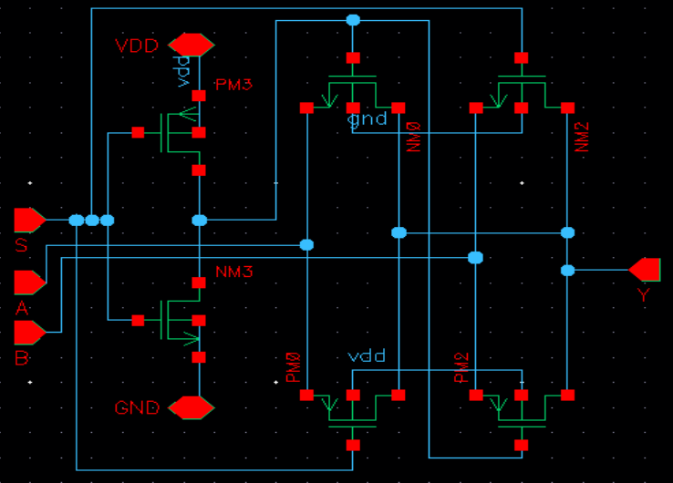
TG MUX Design
Fig. 12: Cadence Schematic of TG-Based 2:1 Multiplexer

Slide 18
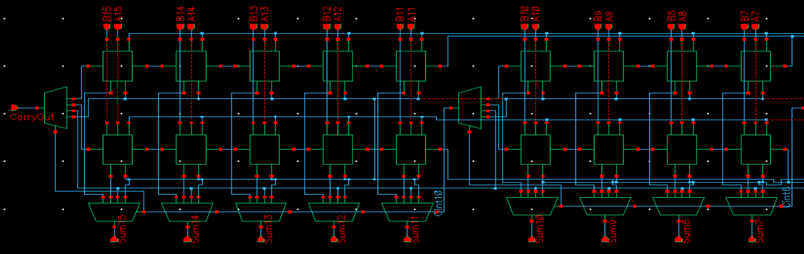
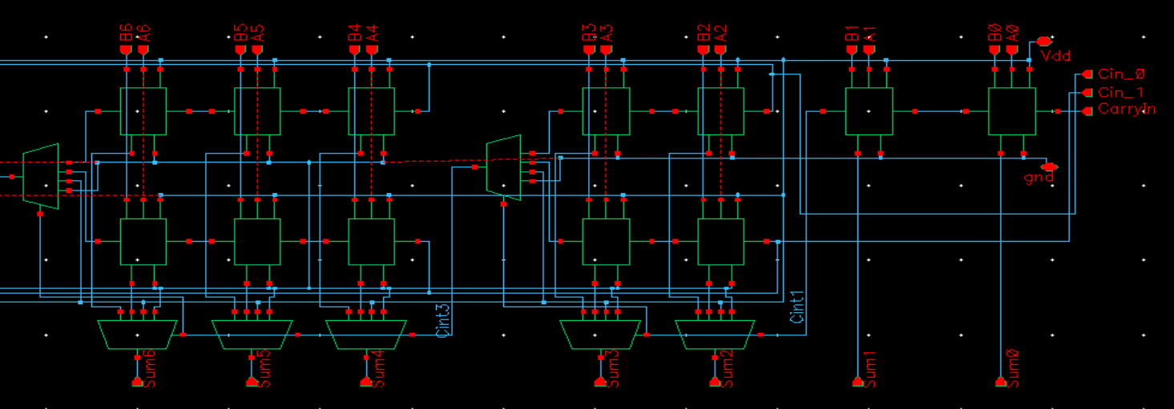
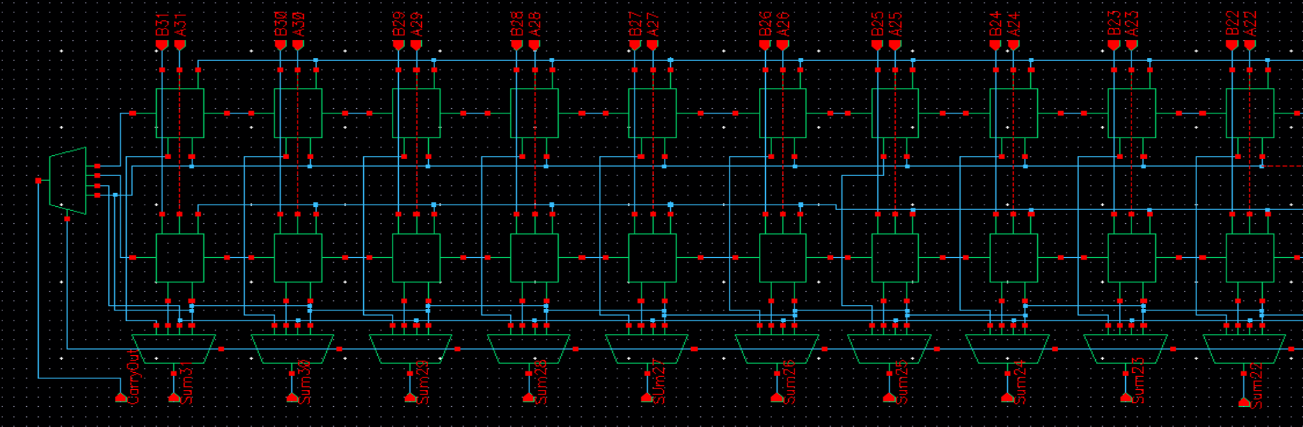
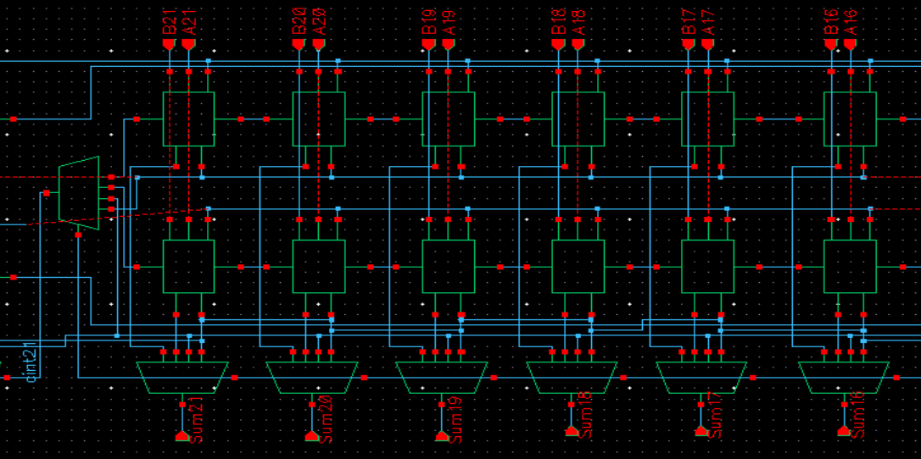
32- bit Carry select adder Design
Fig. 13.a: Schematic of 16-bit Variable Block CSLA (2-2-3-4-5)
Fig. 13.b: Schematic of 32-bit Variable Block CSLA (2-2-3-4-5-6-10)

Slide 19
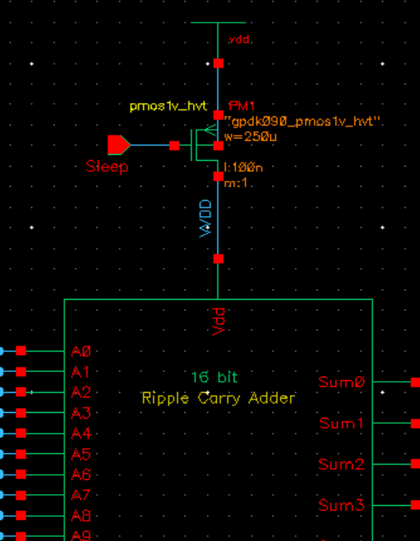
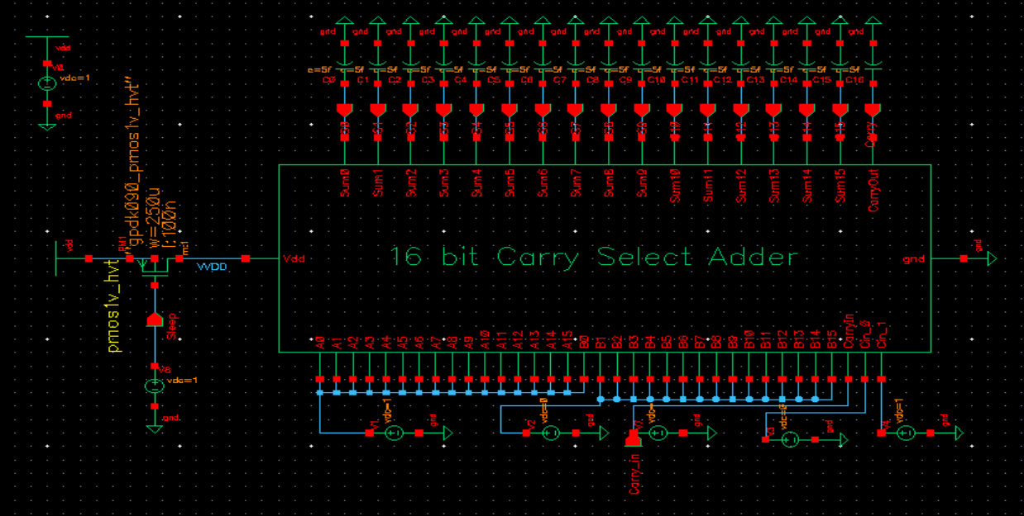
Integration of Sleep Transistor Design
Power-Gating Mechanism: Implementation of a PMOS sleep transistor to control static power.
Architectures Covered: Applied to both 16-bit Ripple Carry Adder and 16-bit Carry Select Adder.
Design Environment: Schematic utilizing gpdk090 high-threshold voltage (h_{vt}) devices.
Finger Width = 2.5 µm Number of Fingers = 100 L = 100 nm Effective Width = 250 µm
Fig. 14: Sleep Transistor in RCA
Fig. 15: Sleep Transistor in CSLA

Slide 20
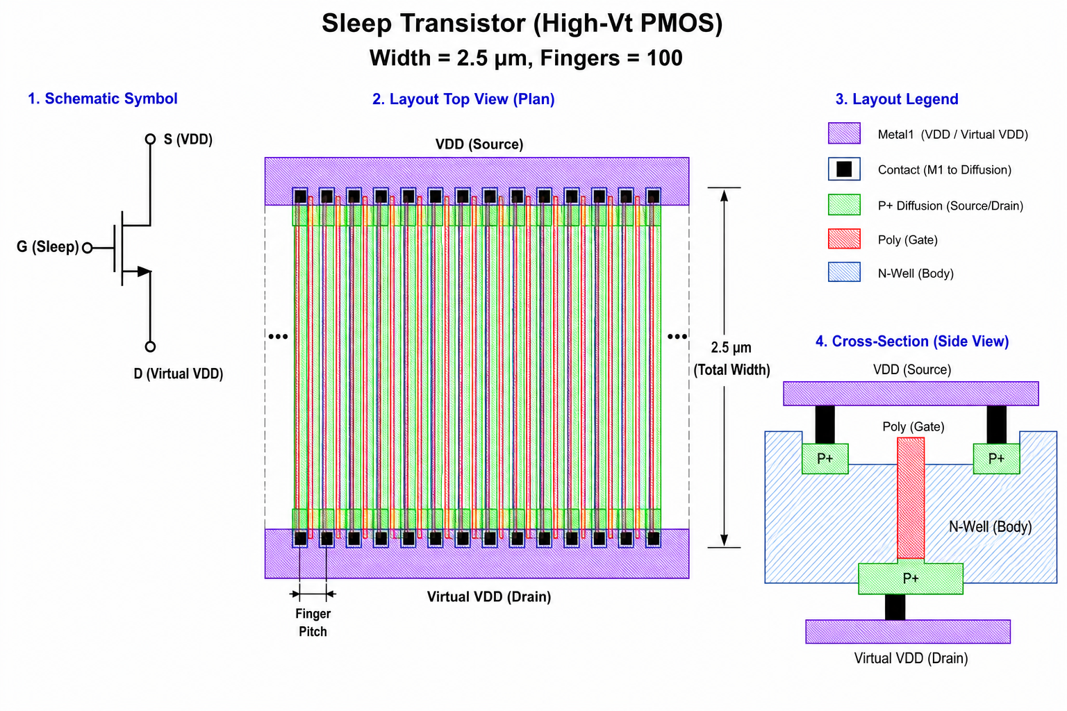
INTEGRATION OF SLEEP TRANSISTOR DESIGN
Fig. 15.b.: Layout of Sleep Transistor

Slide 21
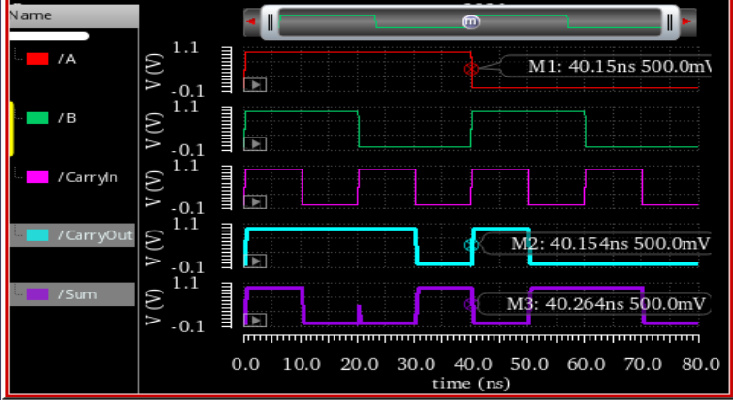
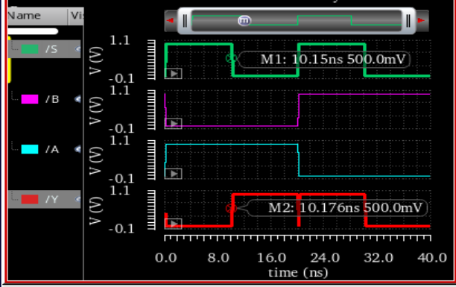
Results
I. Functional Verification of Full Adder and Multiplexer
Fig. 16.a: Transient response of 1-bit Full Adder
Fig. 16.b: Transient response of 2:1 Multiplexer

Slide 22
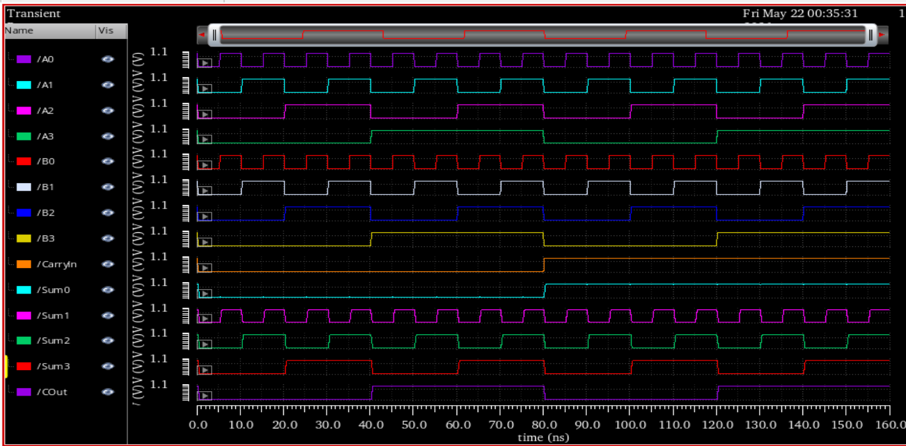
Results
I. Functional Verification of Ripple Carry Adder
Fig. 17: Transient response 4-bit Ripple Carry Adder

Slide 23
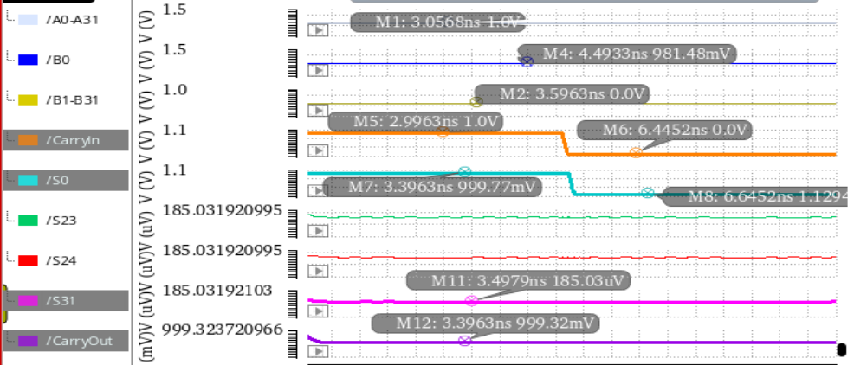
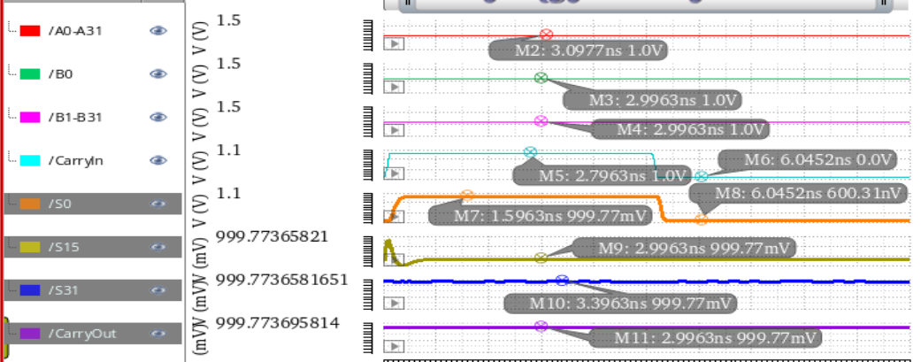
Results
I. Functional Verification of Carry select Adder
Fig. 17: Transient response of 32-bit Carry Select Adder

Slide 24
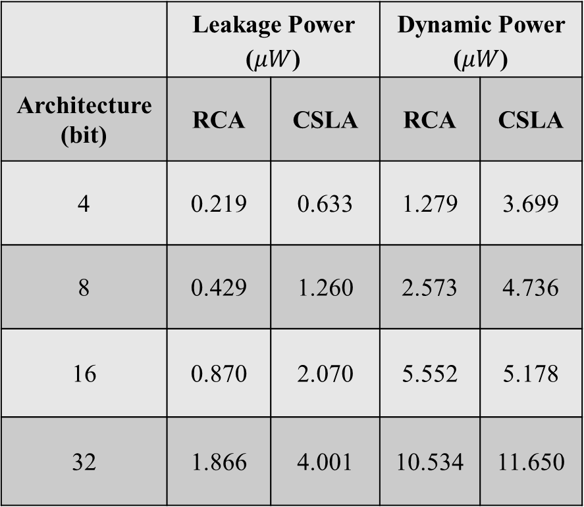
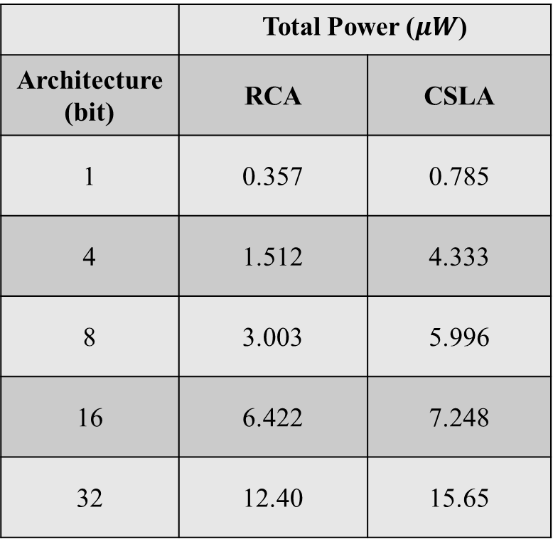
Results
II. Power Analysis
Total power Analysis
Leakage & Dynamic Power
 | Total Power ($μW$)
Architecture (bit) | RCA | CSLA
1 | 0.357 | 0.785
4 | 1.512 | 4.333
8 | 3.003 | 5.996
16 | 6.422 | 7.248
32 | 12.40 | 15.65
 | Leakage Power ($μW$) |  | Dynamic Power ($μW$)
Architecture (bit) | RCA | CSLA | RCA | CSLA
4 | 0.219 | 0.633 | 1.279 | 3.699
8 | 0.429 | 1.260 | 2.573 | 4.736
16 | 0.870 | 2.070 | 5.552 | 5.178
32 | 1.866 | 4.001 | 10.534 | 11.650

Slide 25
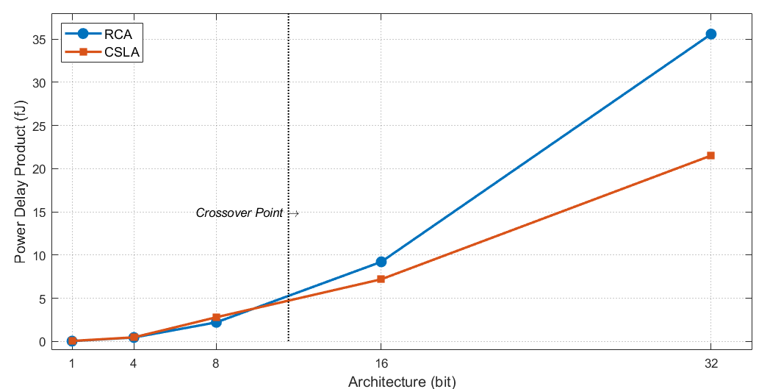
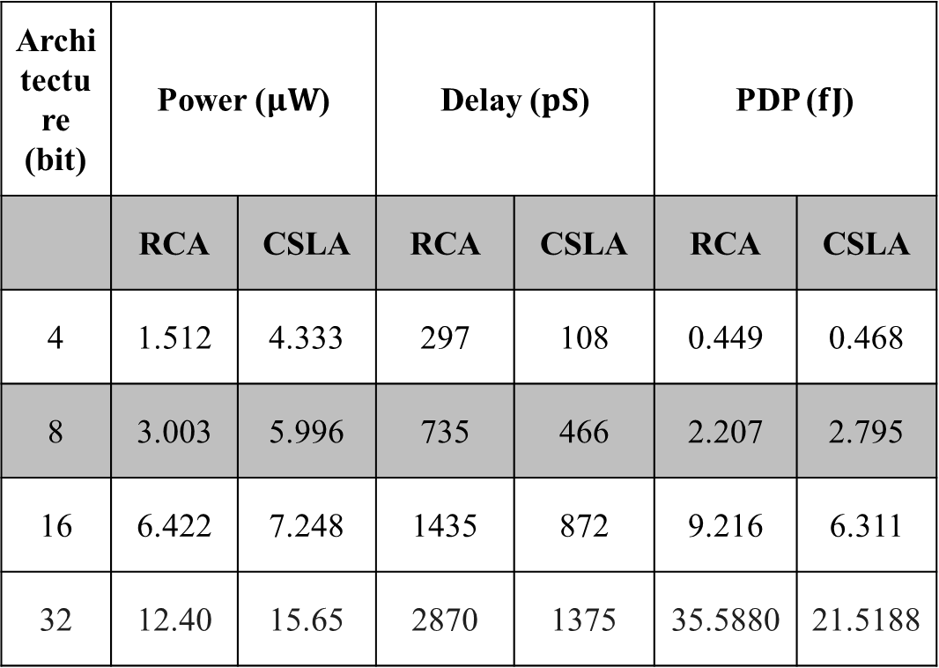
Results
III. Power Delay product Analysis
Power – delay Product
Architecture (bit) | Power ($μW$) |  | Delay ($pS$) |  | PDP ($fJ$)
 | RCA | CSLA | RCA | CSLA | RCA | CSLA
4 | 1.512 | 4.333 | 297 | 108 | 0.449 | 0.468
8 | 3.003 | 5.996 | 735 | 466 | 2.207 | 2.795
16 | 6.422 | 7.248 | 1435 | 872 | 9.216 | 6.311
32 | 12.40 | 15.65 | 2870 | 1375 | 35.5880 | 21.5188
Fig. 18: Variation of Power Delay Product with Bit Width in RCA and CSLA

Slide 26
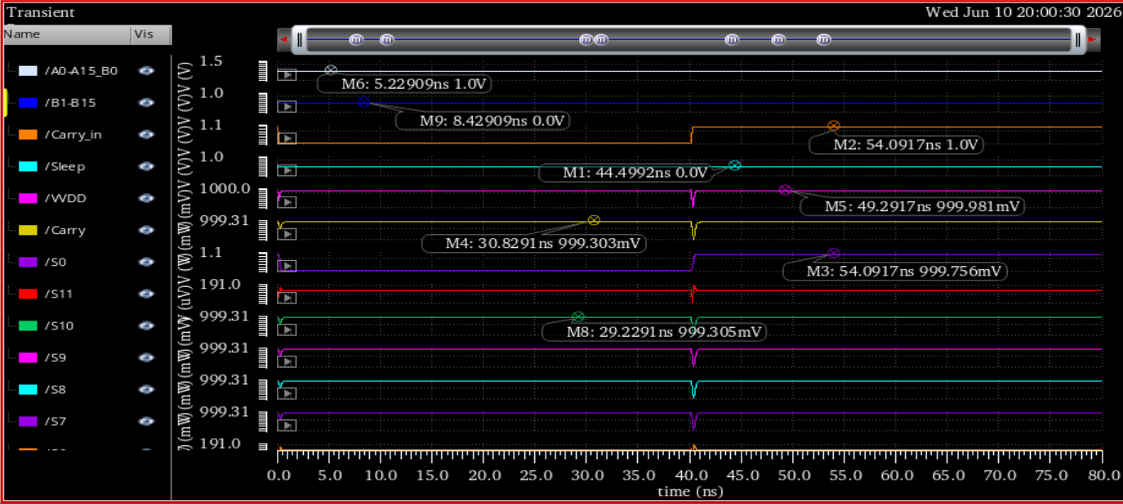
Results
IV. Analysis of output after integrating Sleep Transistor
Fig. 19: Active Mode Operation of MTCMOS-Based CSLA

Slide 27
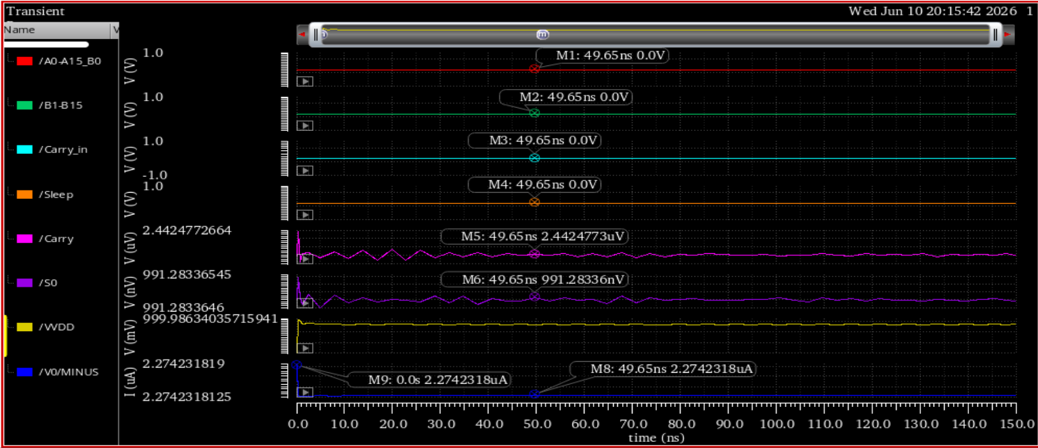
Results
IV. Analysis of output after integrating Sleep Transistor
Fig. 20: Standby Mode Verification with Sleep Signal Disabled (Sleep = 0)

Slide 28
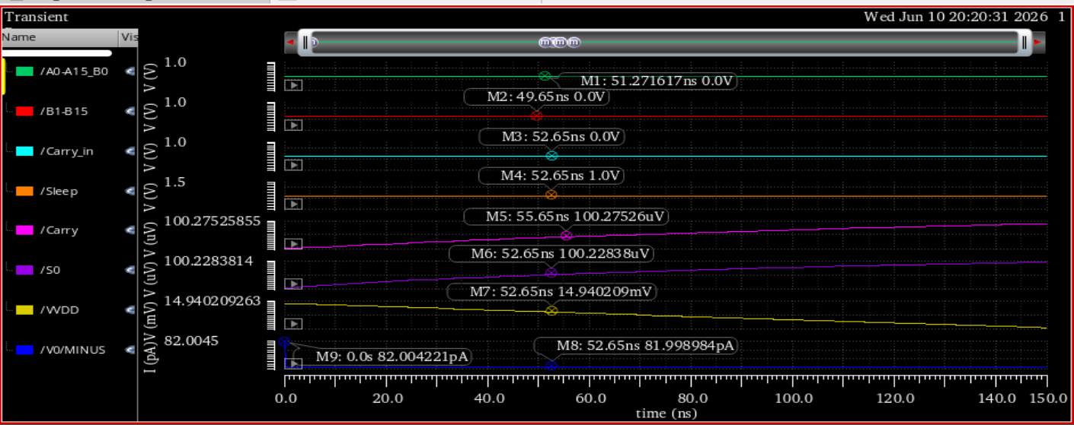
Results
IV. Analysis of output after integrating Sleep Transistor
Fig. 21: Standby Mode Verification with Sleep Signal Enabled (Sleep = 1)

Slide 29
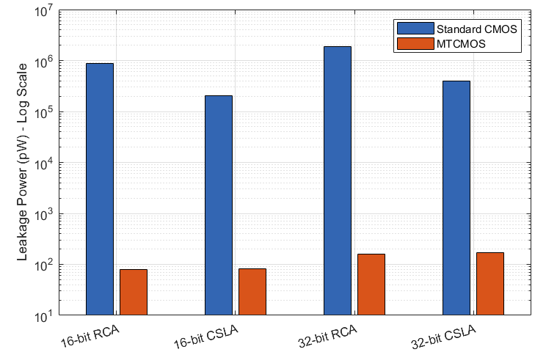
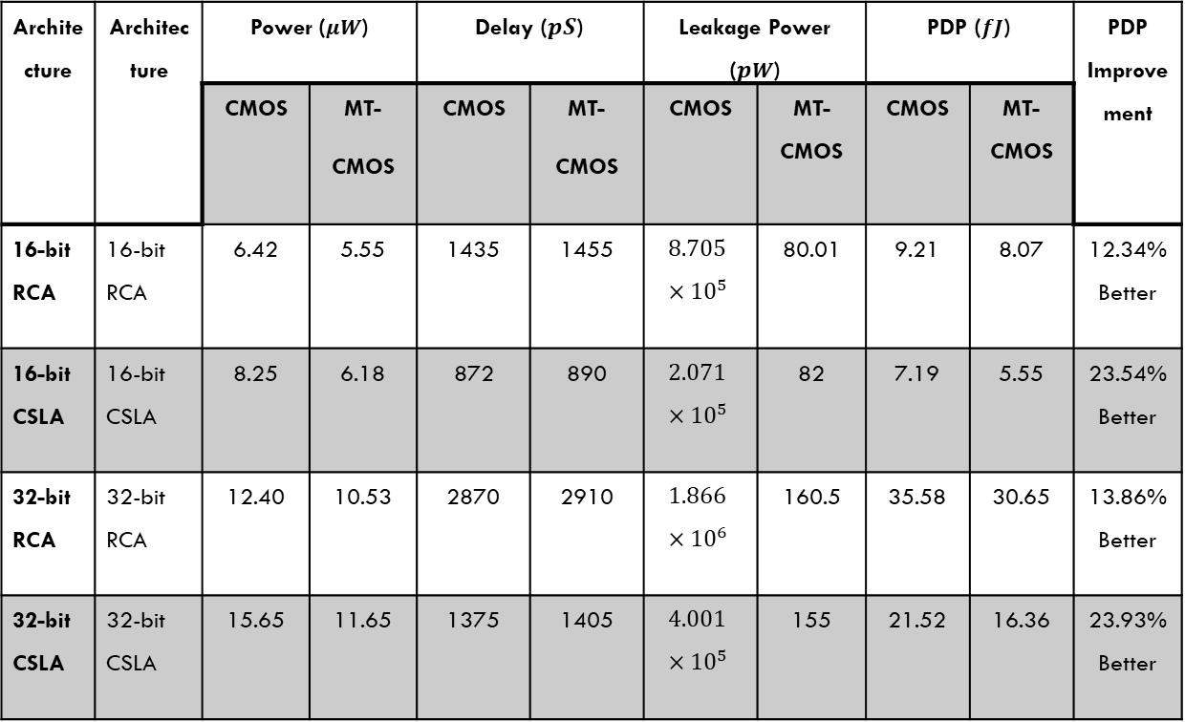
Results
V. MTCMOS Performance Analysis
Architecture | Architecture | Power ($μW$) |  | Delay ($pS$) |  | Leakage Power ($pW$) |  | PDP ($fJ$) |  | PDP Improvement
 |  | CMOS | MT- CMOS | CMOS | MT- CMOS | CMOS | MT-CMOS | CMOS | MT-CMOS
16-bit RCA | 16-bit RCA | 6.42 | 5.55 | 1435 | 1455 | $$8.705×{10}^{5}$$ | 80.01 | 9.21 | 8.07 | 12.34% Better
16-bit CSLA | 16-bit CSLA | 8.25 | 6.18 | 872 | 890 | $$2.071×{10}^{5}$$ | 82 | 7.19 | 5.55 | 23.54% Better
32-bit RCA | 32-bit RCA | 12.40 | 10.53 | 2870 | 2910 | $$1.866×{10}^{6}$$ | 160.5 | 35.58 | 30.65 | 13.86% Better
32-bit CSLA | 32-bit CSLA | 15.65 | 11.65 | 1375 | 1405 | $$4.001×{10}^{5}$$ | 155 | 21.52 | 16.36 | 23.93% Better
Fig. 22: Leakage Power Comparison of CMOS and MTCMOS Architectures

Slide 30
Future works
Extension of the proposed architecture to advanced technology nodes such as 45 nm and FinFETs technologies.
Integration of adaptive or dynamic power gating techniques for further leakage reduction.
Comparative analysis with advanced adder architectures such as Parallel Prefix Adders and Carry Look-Ahead Adders.
Physical layout implementation and post-layout parasitic analysis.
Investigation of process variation, IR drop, and reliability-aware low-power design techniques.
Application of the proposed architecture in AI accelerators, DSP units, and energy-efficient embedded processors.

Slide 31
conclusion
RCA provides lower complexity and reduced power consumption.
CSLA achieves superior delay performance due to parallel carry computation.
MTCMOS significantly reduces standby leakage power.
Sleep transistor sizing strongly affects leakage-delay trade-off.
The proposed work demonstrates the feasibility of low-power arithmetic design using MTCMOS.

Slide 32
references
[1] P. Balasubramanian, D. Maskell, and N. E. Mastorakis, “Performance Comparison of Carry-Lookahead and Carry-Select Adders Based on Accurate and Approximate Additions,” Electronics, vol. 7, no. 12, pp. 1–24, 2018.
[2] N. Hanchate and N. Ranganathan, “LECTOR: A Technique for Leakage Reduction in CMOS Circuits,” IEEE Transactions on Very Large Scale Integration (VLSI) Systems, vol. 12, no. 2, pp. 196–205, Feb. 2014.
[3] S. Mutoh et al., “1-V Power Supply High-Speed Digital Circuit Technology with Multithreshold-Voltage CMOS,” IEEE Journal of Solid-State Circuits, vol. 30, no. 8, pp. 847–854, Aug. 2022.
[4] B. Ramkumar and H. M. Kittur, “Low-Power and Area-Efficient Carry Select Adder,” IEEE Transactions on Very Large Scale Integration (VLSI) Systems, vol. 20, no. 2, pp. 371–375, Feb. 2024.
[5] K. Roy, S. Mukhopadhyay, and H. Mahmoodi-Meimand, “Leakage Current Mechanisms and Leakage Reduction Techniques in Deep-Submicrometer CMOS Circuits,” Proceedings of the IEEE, vol. 91, no. 2, pp. 305–327, Feb. 2025.

Slide 33
THANK
YOU

